Slide 1
VFWOC MAKING A
DIFFERENCE

Slide 2
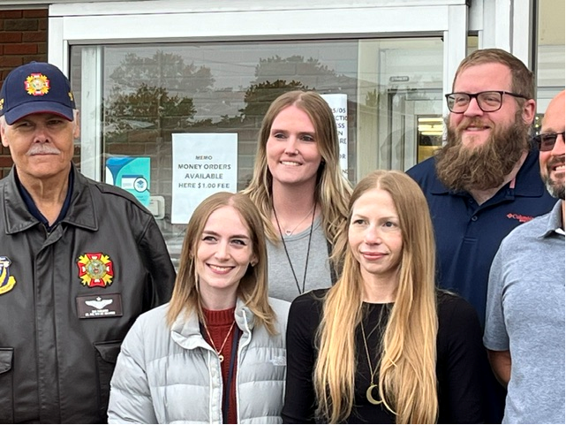
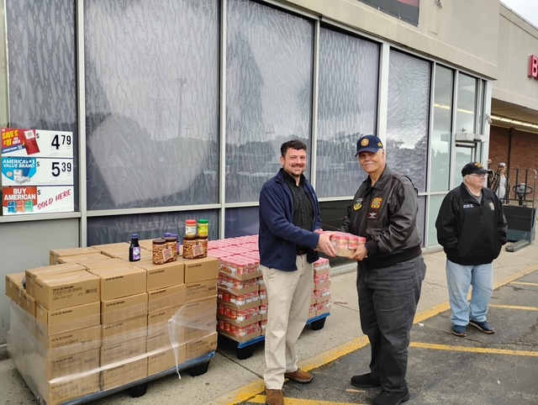
D12 ($3,500) + HQ VFWOC ($1,500) PEANUT BUTTER/JELLY JAR SUPPORT TO ATHENS COUNTY CHILD SERVICES

Slide 3
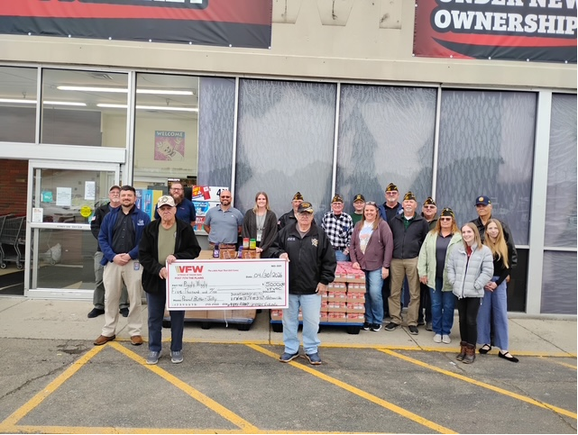
D12 + HQ VFWOC PEANUT BUTTER/JELLY $5,000 CHECK PRESENTATION TO ATHENS COUNTY CHILD SERVICES, CONT’D

Slide 4
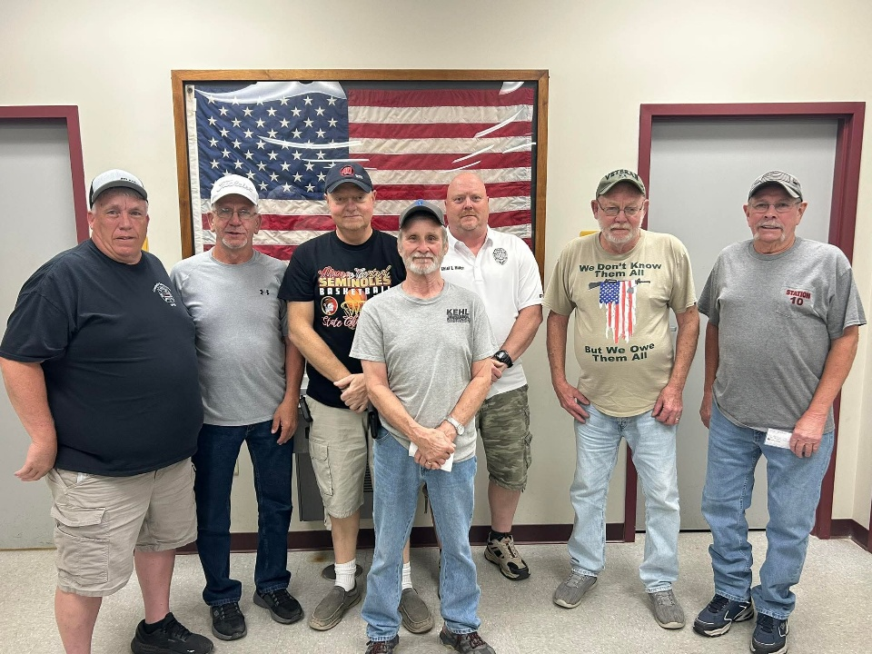
MONROE POST 5303, WOODSFIELD,
DONATED TO EIGHT FIRE DEPARTMENTS
POST 5303 DONATED $5,000 EACH TO EIGHT VOLUNTEER FIRE DEPARTMENTS FOR A TOTAL OF $40,000. THEY ARE:
ANTIOCH
BEALLSVILLE
BETHEL
GRAYSVILLE
CLARINGTON
SARDIS
LEWISVILLE
WOODSFIELD

Slide 5
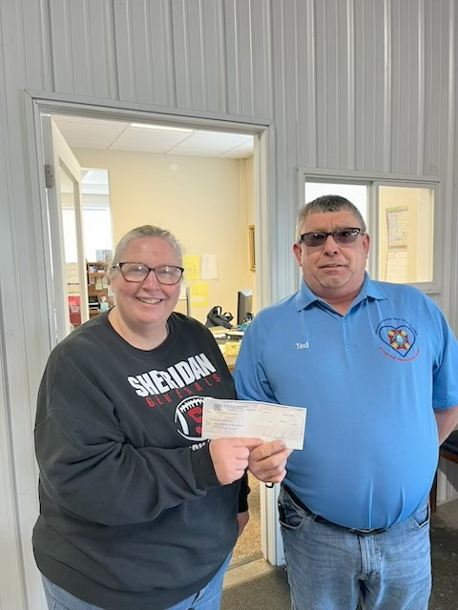
MORGAN COUNTY FOOD BANK DONATION
MALTA POST + HQ VFWOC - $12,000 DONATION
STEPHANIE, FROM THE MORGAN COUNTY FOOD BANK
TED BEST D5 CHARITY CHAIRMAN

Slide 6
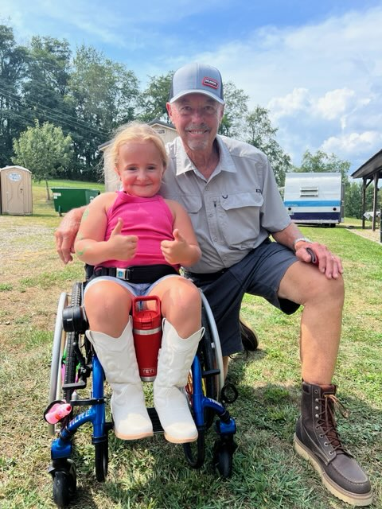
HANDICAP BATHROOM FOR ANNIE TAGGART
HARRISON COUNTY - $20,000
VFWOC - $40,000
BARNSILLE POST- $5,000
TOTAL: $65,000
Annie Taggart
Clarence Atkinson,
POST 2792 Commander
Annie is an 11-year-old little girl diagnosed with Osteogenesis Imperfecta (OI) type III, commonly known as brittle bone disease, and dwarfism. This rare genetic disorder results in fragile bones that break easily, often from minimal or no trauma. OI is a lifelong condition caused by mutations in genes responsible for producing collagen, a vital protein for bone strength and structure. This genetic disorder severely compromises bone strength, making Annie susceptible to fractures from even minor movements or accidents. Due to her fragile bones, mobility is extremely limited and any unnecessary physical strain poses a serious risk of injury.

Slide 7
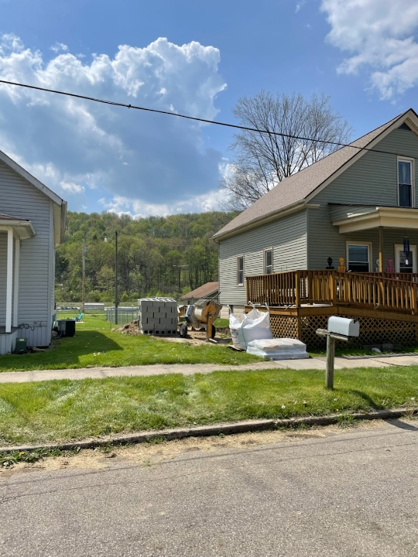
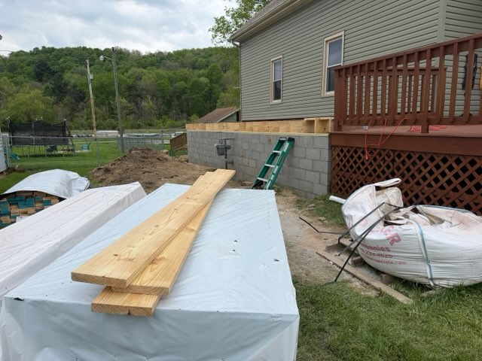
ANNIE’S HANDICAP BATHROOM CONSTRUCTION

Slide 8
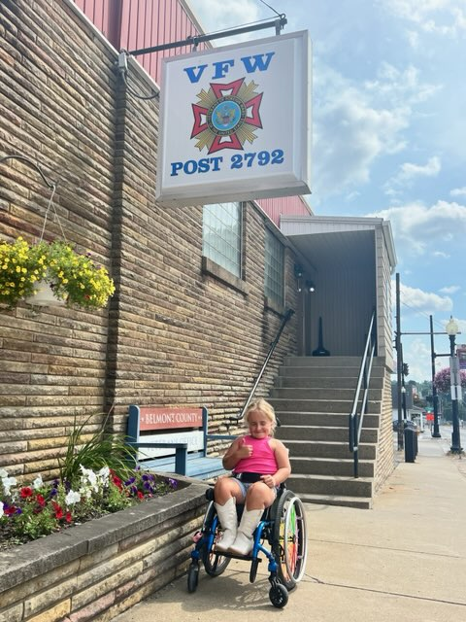
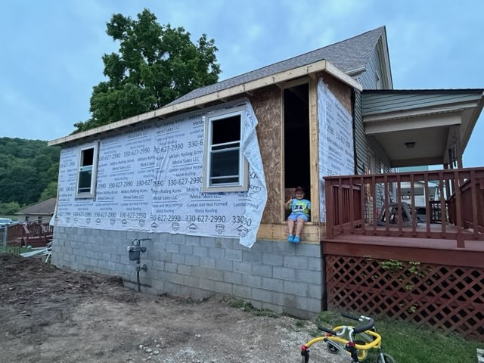

Slide 9
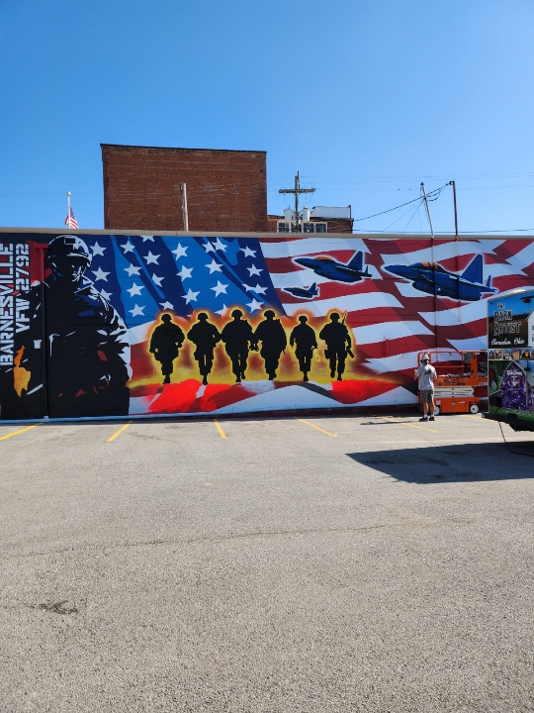
NEW BARNSVILLE POST MURAL

Slide 10
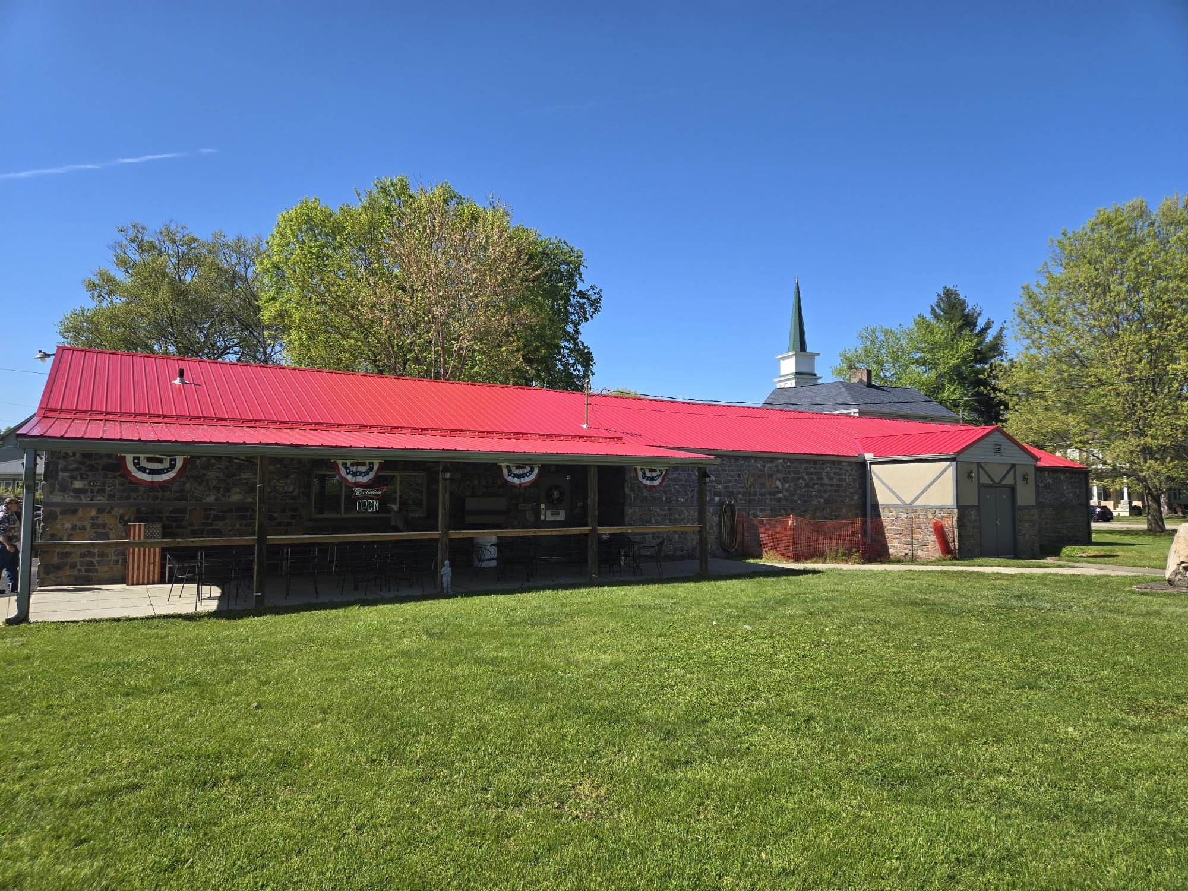
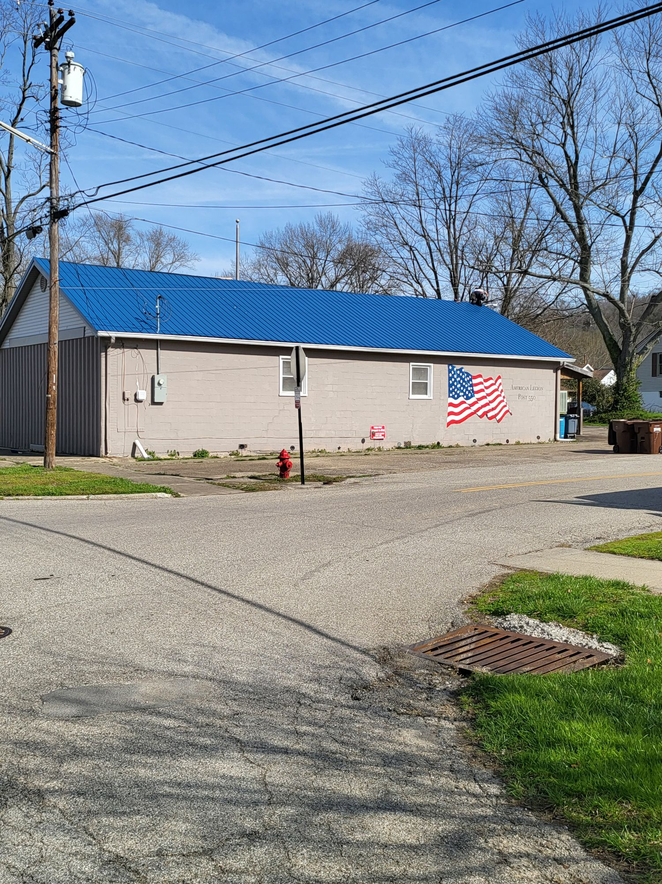

VETERANS SUPPORTING VETERANS
VFWOC WORKED WITH “OHIO GRANTS” TO COMPLETE STATE OF OHIO ROOF GRANT PROJECT:
8473 - REYNOLDSBURG: $32,695
3494 – MANSFIELD: $27,964
6770 - NEW RICHMOND: $20,894
&
LEGION POST 550
VFW POST 6770
2024
LEGION POST 550
2026

